Slide 1
introduction to Object Oriented Programming, and the file object.
Week 3 | Lecture 3 (3.3)
While waiting for class to start:
Download and open the Jupyter Notebook (.ipynb) for Lecture 3.3
You may also use this lecture’s JupyterHub link instead (although opening it locally is encouraged).
Upcoming (Today!):
Reflection 3 released Friday @ 11 AM
Lab 3 deadline this Friday @ 11 PM
PRA (Lab) on Friday @ 2PM this week (ONLINE)
Midterm - May 31 in lecture @ 9:10 AM

Slide 2
This Week’s Content
Lecture 3.1
Objects & Strings: Operators and Methods
Strings: Conversions, Indexing, Slicing, and Immutability
Lecture 3.2
For Loops
Looping over Strings
Lecture 3.3
Introduction to Object-Oriented Programming and the File Object

Slide 3
Procedural vs Object-Oriented
“Object-oriented programming (OOP) is a programming paradigm based on the concept of “objects”, which may contain data, in the form of fields, often known as attributes; and code, in the form of procedures, often known as methods.” — Wikipedia
“Procedural programming is a programming paradigm, derived from structured programming, based upon the concept of the procedure call. Procedures, also known as routines, subroutines, or functions, simply contain a series of computational steps to be carried out.” — Wikipedia

Slide 4

Procedural Programming
Real World
Data
Global Variable
Pedestrian 1
x, y Location
Global Variable
Pedestrian 2
x, y Location
Global Variable
Pedestrian 3
x, y Location
x_ped1 = 3
y_ped1 = 5
Global Variable
Traffic Light 1
Color
Global Variable
Car 1
x, y location
traffic_light = ‘red’
Separation of Data and Functions
Function
OK to Cross
Function
Advance Position
Function
Pedestrian in Intersection

Slide 5
Procedural Programming
Real World
Data
Global Variable
Pedestrian 1
x, y Location
Global Variable
Pedestrian 2
x, y Location
Global Variable
Pedestrian 3
x, y Location
Global Variable
Traffic Light 1
Color
Global Variable
Car 1
x, y location
input
output
Function
OK to Cross
Function
Advance Position
Function
Pedestrian in Intersection

Slide 6
Object-Oriented Programming
Real World
Data
Car Object
x, y Location
Pedestrian in Intersection
Advance Position
Traffic Light Object
Color
Change Color
Encapsulation of Data and Functions, like real life!
Pedestrian Object
x, y Location
Ok to Cross
Advance Position

Slide 7
Object-Oriented Programming
Often, an object definition corresponds to some object or concept in the real world.
The functions that operate on that object correspond to the ways real-­world objects interact.
Models our real-life thinking
Sandwich – ingredients, freshness, etc.
Car – model, year, fuel level, forward, reverse etc.
Cat – weight, name, colour, scratch, meow, sleep, etc.
Turtle Object – x_position, y_position, forward, up, left, etc.

Slide 8
Object-Oriented Programming
Data
Functions
def up(y):
return y + 1
def goto(x_new, y_new):
return x_new, y_new
def right(x):
return x + 1
Procedural
Object-Oriented
alex_x = 0
alex_y = 0
alex_y = up(alex_y)
alex_x, alex_y = goto(-150, 100)
alex_x = right(alex_x)
print(alex_x, alex_y)
alex = Turtle(0, 0)
alex.up()
alex.goto(-150, 100)
alex.right()
print(alex.x, alex.y)

Slide 9
Objects in Python
Is this an instance
of this class.
Everything in Python is an object.
Every value, variable, function, etc., is an object.
Every time we create a variable we are making a new object.
>>> isinstance(4, object)
True
>>> isinstance(max, object)
True
>>> isinstance(“Hello”, object)
True

Slide 10
Classes
Class
A template or blueprint for object types
An instance of a class refers to one object whose type is defined as the class.
The words "instance" and "object" are used interchangeably.
A Class is made up of attributes (data) and methods (functions).
Attributes
Data
Methods
Functions
str.upper(‘hello’)
‘hello’.upper()

Slide 11

Classes
Person
Instances (objects) of the Person class.
name
age
city
gender
name: Majid
age: 28
city: Toronto
gender: they/them
name: June
age: 34
city: Ottawa
gender: she/her
eat
study
sleep
play
name: Ted
age: 31
city: Kingston
gender: he/him

Slide 12


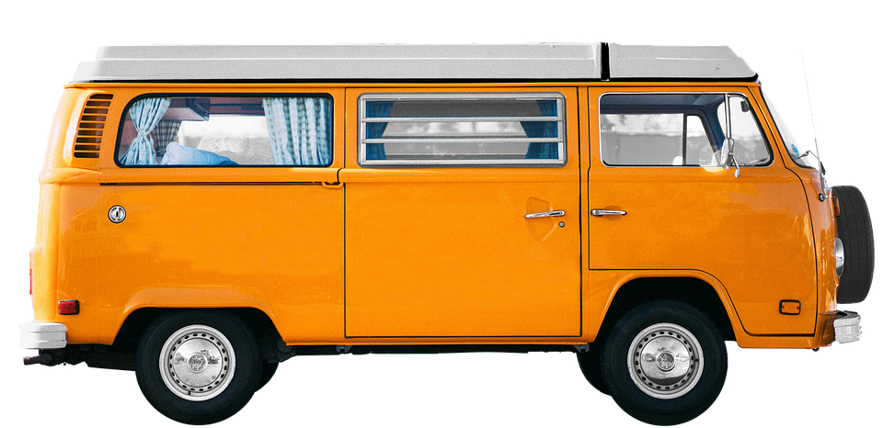
Classes
Car
Instances (objects) of the Car class.
model: Model S
company: Tesla
year: 2017
color: blue
model
company
year
color
model: Corolla
company: Toyota
year: 1980
color: red
brake
accelerate
open trunk
model: Bus
company: Volkswagen
year: 1976
color: orange

Slide 13

Classes
Turtle
Instances (objects) of the Turtle class.
name
x location
y location
name: Vinodh
x location: 134
y location: 45
name: Lucy
x location: 24
y location: 35
move up
move down
move left
move right
go to
name: Brian
x location: 92
y location: 62

Slide 14
We’ve already been using objects!
math
integer
string
pi
e
inf
…
is_integer
as_integer_ratio
to_bytes
from_bytes
bit_count
…
replace
find
rfind
upper
isupper
islower
capitalize
count
…
factorial
ceil
floor
isfinite
log
…

Slide 15

Classes
File
Instances (objects) of the file class.
filename
mode (ex: read or write)
name: itinerary.txt
mode: write
name: bills.txt
mode: append
read
readline
write
close
…
name: grades.txt
mode: read

Slide 16
Classes
This code existed somewhere when you wrote Lab 1, but we didn’t need to know the details to be able to use them!
We will learn more about building custom classes later (Week
class Turtle:
def __init__(self, x, y):
self.x = x
self.y = y
def up(self):
body
def goto(self, x, y):
body
def down(self):
body
alex = Turtle(0, 0)
alex.up()
alex.goto(-150, 100)
alex.down()
print(alex.x, alex.y)

Slide 17
Let’s Code!
Let’s take a look at how this works in Python!
Objects in Python
One potential ACORN design
Breakout Session!
Click Link:
1. Objects in Python

Slide 18

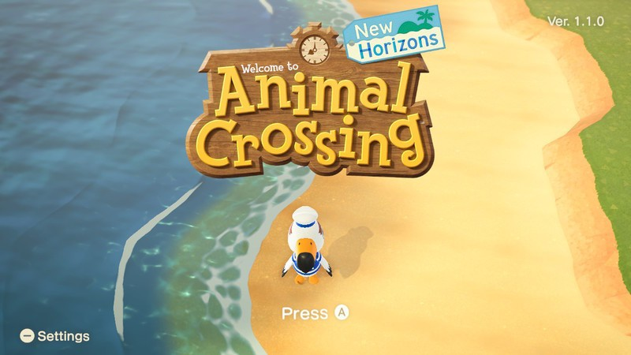
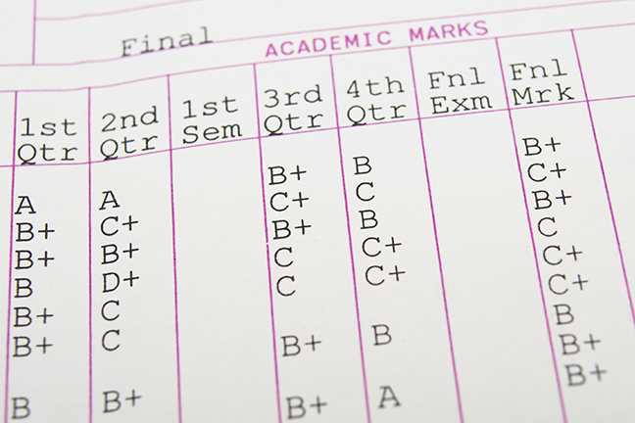
Why do we care about files?
Everything we’ve done so far is essentially deleted when our program ends
What if we wanted to store information?

Slide 19

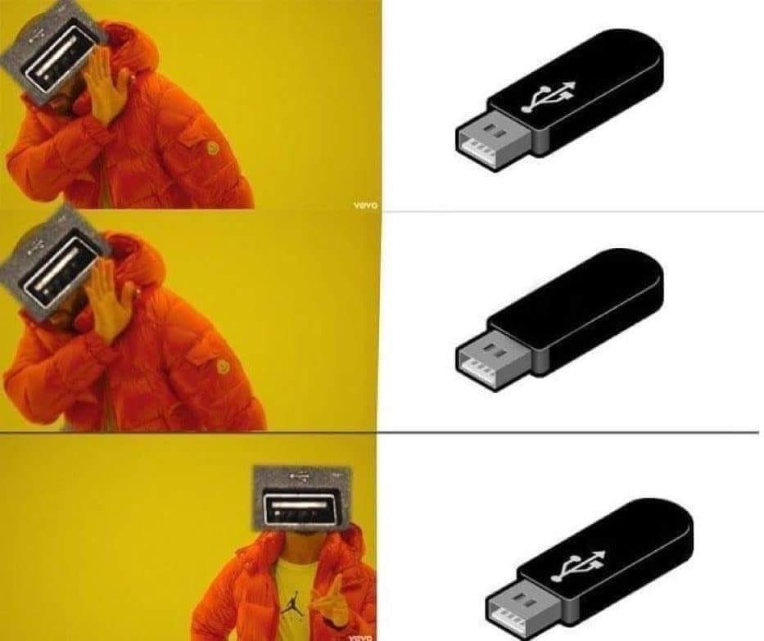
Why work with files?
Recall from Week 1: While a program is running, its data is stored in random access memory (RAM). RAM is fast and inexpensive, but it is also volatile, which means that when the program ends data in RAM disappears.
To make data available the next time the program is started, it must be written to a non-volatile storage medium, such a hard drive, USB drive, cloud storage, or CD-R.

Slide 20

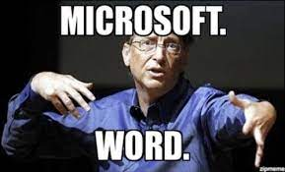
Why work with files?
Data on non-volatile storage media are stored in named locations on the media called files.
By reading and writing files, programs can save information between program runs.

Slide 21

It’s like working with a notebook!
A file must be opened.
When you are done, it has to be closed.
While the file is open, it can either be read from or written to.
Like a bookmark, the file keeps track of where you are reading to or writing from.
You can read the whole file in its natural order or you can skip around

Slide 22
Opening a File
Python has a built-in function open that creates and returns a file object with a connection between the file information on the disk and the program.
The general form for opening a file is:
where mode is 'r' (to open for reading), 'w' (to open for writing), or 'a' (to open for appending to what is already in the file).
filename is an external storage location.
open(filename, mode)

Slide 23
Writing to a File
The following statement opens the file test.txt in write mode ‘w’.
If there is no file named "test.txt" on the disk, it will be created. If there already is one, it will be replaced by the file we are writing.
The file information will be assigned to the file object myfile.
myfile = open(‘test.txt’, ‘w’)

Slide 24
Writing to a File
To write something we need to use the write method as shown:
The write method does not attach a new line character by default.
Every time we use myfile.write() a string is added to file “test.txt” where we left off.
myfile.write(‘CATS!…’)
myfile.write(‘\n’)
myfile.write(‘I <3 my second line… \n’)

Slide 25
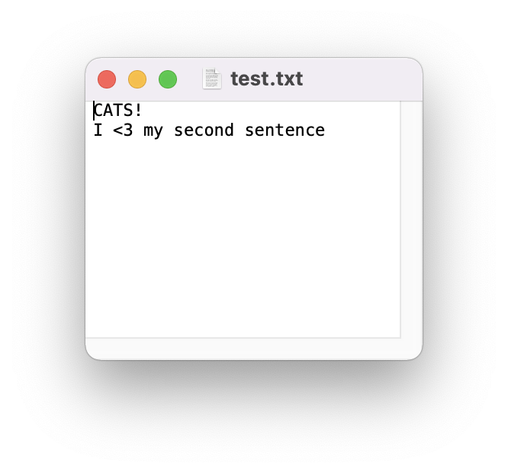
myfile = open(‘test.txt’, ‘w’)
myfile.write(‘CATS!…’)
myfile.write(‘\n’)
myfile.write(‘I <3 my second sentence… \n’)

Slide 26
Closing a File
Once you have finished with the file, you need to close it:
This tells the system that we are done writing and makes the disk file available for reading or writing by other programs (or by our own program).
myfile.close()

Slide 27
Let’s Code!
Let’s take a look at how this works in Python!
Writing to your first file
Figure out where your files are getting saved!
Current working directory
Try playing with “w” and “a” mode!
Breakout Session!
Click Link:
2. The File Object

Slide 28

CLOSE THE FILE!
myfile.close()
Always close a file that you’ve opened!
Many changes don’t occur until after the file is closed
Leaving open is a waste of a computer’s resources
Slows down program, uses more space in RAM, impacts performance
Other files may treat the file as “open” and won’t be able to read the file
Could run into limits about how many files you have open
Not #cleancode

Slide 29

The ”Writing to Files” Recipe
# open/create a file
myfile = open("grades.txt", "w")
# write to a file
myfile.write(’string’)
# close the file
myfile.close()
go together

Slide 30
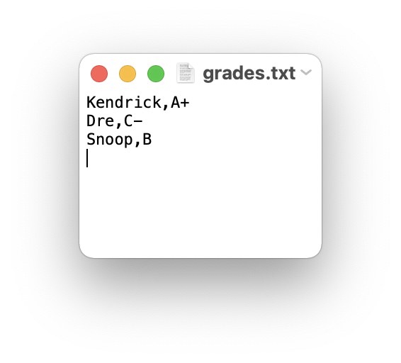
Example: Writing to Files
How would we write a string to a file?
students = ‘Kendrick,A+\nDre:C-\nSnoop:B\n’
# create a file
myfile = open("grades.txt", "w")
# store string to the file
myfile.write(students)
# close the file
myfile.close()

Slide 31
Encapsulation
Encapsulation
seb.forward(50)
kitty.scratch()
The core of object-oriented programming is the organization of the program by encapsulating related data and functions together in an object.
To encapsulate something means to enclose it in some kind of container.
In programming, encapsulation means keeping data and the code that uses it in one place and hiding the details of exactly how they work together.
Class
Attributes
Methods

Slide 32
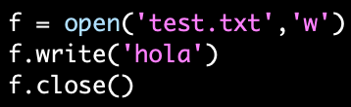
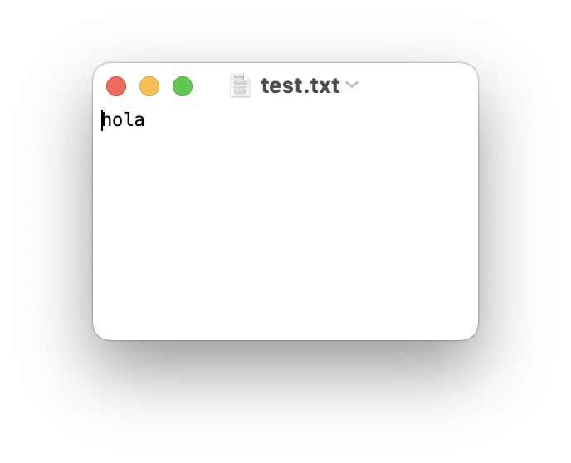
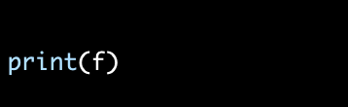
Encapsulate it!
For example, each instance of class file keeps track of which file on the disk it is reading/writing and where it currently is on that file.
The class hides the details of how it is done, so we (as programmers) can use it without needing to know how it is implemented

Slide 33


Writing and Reading
Can be any name!
myfile = open(‘test.txt’, ‘w’)
'w’ OR ‘a’
myfile = open(‘test.txt’, ‘a’)
myfile.write(‘CATS!…’)

Slide 34
Different ways of Reading a File
Reading a file is similar to writing a file. First we need to open a file for reading (“r”):
If file doesn’t exist? ERROR
Then to read a file we apply one of the following approaches which take advantage of various read methods:
The read approach
The readline approach
The for line in file approach
The readlines approach
myfile = open(‘test.txt’, ‘r’)
No correct approach!
Multiple methods to help with contexts and purposes

Slide 35
Different ways of Reading a File
Approach | Code | When to use it
The read approach | myfile = open(filename, 'r') contents = myfile.read() myfile.close() | When you want to read the whole file at once and use it as a single string.
The readline approach | myfile = open(filename, 'r') contents = '' line = myfile.readline() while line != '': contents += line line = myfile.readline() myfile.close() | When you want to process only part of a file. Each time through the loop line contains one line of the file.
The for line in file approach | myfile = open(filename, 'r') contents = '' for line in myfile: contents += line myfile.close() | When you want to process every line in the file one at a time.
The readlines approach | myfile = open(filename, 'r') lines = myfile.readlines() myfile.close() | When you want to examine each line of a file by index.
TODAY
FUTURE

Slide 36
Let’s Code!
Let’s take a look at how this works in Python!
Different read approaches
read()
readline()
for line in file
readlines()
Open your notebook
Click Link:
3. Reading Files

Slide 37
Madlibs is a story game
A story is written, and a few important words are taken out, replaced by blanks
The blanks are labelled with their part of speech or other category ("noun", "adjective", "an animal", and so on)
Replace the categories with specific words without knowing the story
When all the blanks have been filled in, the story is read out, usually with comic results
Example: https://youtu.be/kM9Wuzj4k24

Slide 38
Let’s Code!
Let’s take a look at how this works in Python!
Bringing it all together with Madlibs!
Open your notebook
Click Link:
4. Madlibs

Slide 39
introduction to Object Oriented Programming, and the file object.
Week 3 | Lecture 3 (3.3)
While waiting for class to start:
Download and open the Jupyter Notebook (.ipynb) for Lecture 3.3.1
You may also use this lecture’s JupyterHub link instead (although opening it locally is encouraged).
Upcoming (Today!):
Reflection 3 released Friday @ 11 AM
Lab 3 deadline this Friday @ 11 PM
PRA (Lab) on Friday @ 2PM this week (ONLINE)
Midterm - May 31 in lecture @ 9:10 AM

